Slide 1
Chapter 18: Fourier Circuit Analysis
Part I

Slide 2
Outline
Trigonometric Form of the Fourier Series
The Use of Symmetry
Complete Response to Periodic Forcing Function

Slide 3
18.1 Trigonometric Form of the Fourier Series
In this section, we refocus our attention on forcing functions that are sinusoidal in nature, and
Discover how to write a general periodic function as a sum of such functions—leading us into a discussion of a new set of circuit analysis procedures.

Slide 4

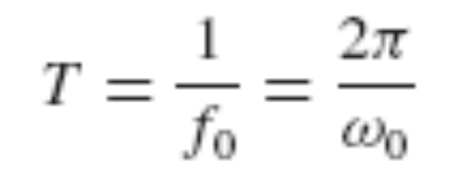
Harmonic
Let us first assume a cosine function of radian frequency ω₀,
where ω₀ = 2πf₀ and the period T is
T is the period of the fundamental frequency.
The harmonics of this sinusoid have frequencies nω₀, where ω₀ is the fundamental frequency and n = 1, 2, 3,…
The frequency of the first harmonic is the fundamental frequency.

Slide 5
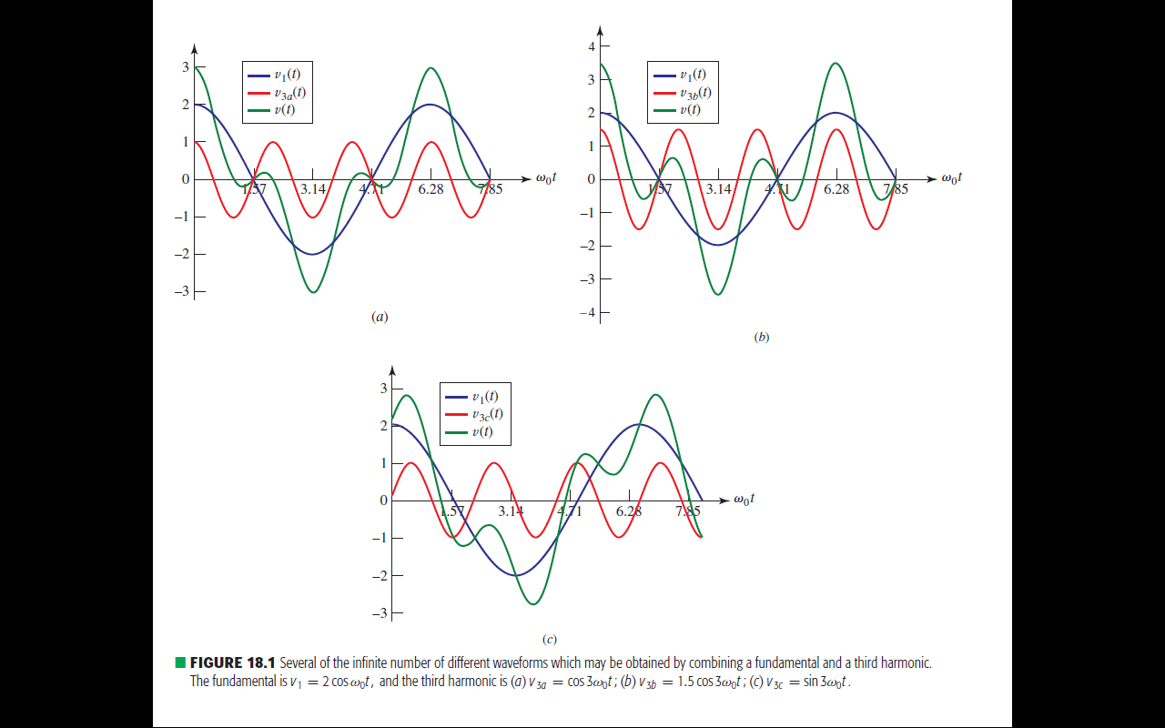



Next, let us select a third-harmonic voltage
The fundamental v₁(t), the third harmonic v_{3a}(t), and the sum of these two waves are shown as functions of time in Fig. 18.1a.
It should be noted that the sum is periodic, with period T = 2π/ω₀.

Slide 6



Fig. 18.1b shows the effect of combining v₁(t) and a third harmonic of slightly larger amplitude,

Slide 7
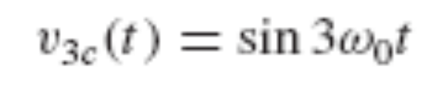


By shifting the phase of the third harmonic by 90 degrees to give
the sum shown in Fig. 18.1c. In all cases, the period of the resultant waveform is the same as the period of the fundamental waveform. We are able to generate waveforms which have extremely nonsinusoidal characteristics by an appropriate combination of sinusoidal functions.

Slide 9
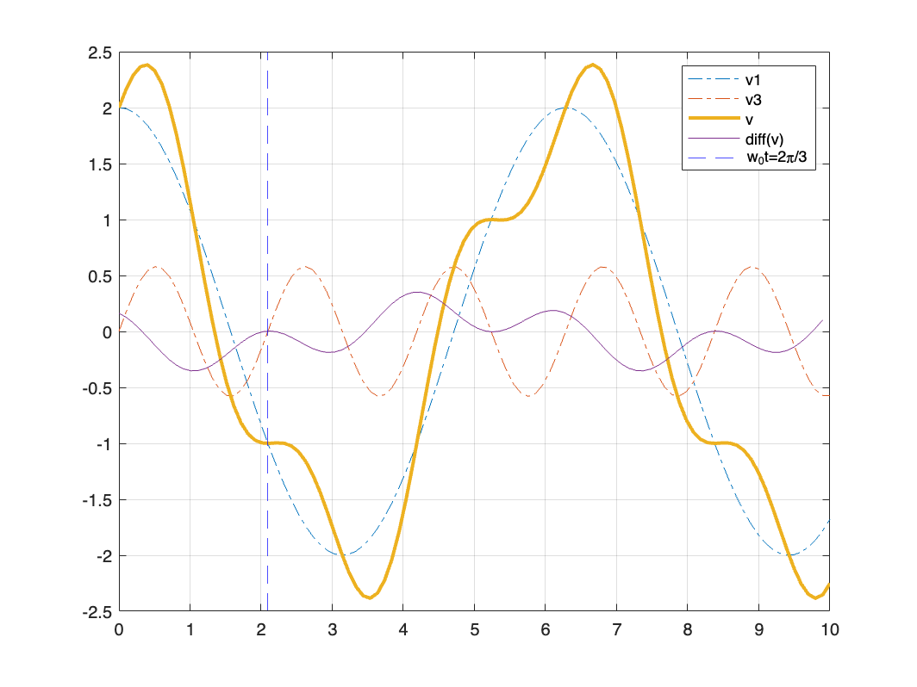
Practice 18.1
Let a third-harmonic voltage be added to the fundamental to yield v = 2cosω₀t +V_{in3} sin 3ω₀t, the waveform shown in Fig. 18.1 c for V_{in3} = 1.
(a) Find the value of V_{in3} so that v(t) will have zero slope at
ω₀t = 2π/3.
(b) Evaluate v(t) at ω₀t = 2π/3.
Ans: 0.577; – 1.000.

Slide 10

Fourier Series
Consider a periodic function f(t),
where T is the period. Further assume that the function f(t) satisfies the following properties:
1. f(t) is single-valued everywhere.
2. The integral
exists for any choice of t₀.
3. f(t) has a finite number of discontinuities in any one period.
4. f(t) has a finite number of maxima and minima in any one
period.

Slide 11
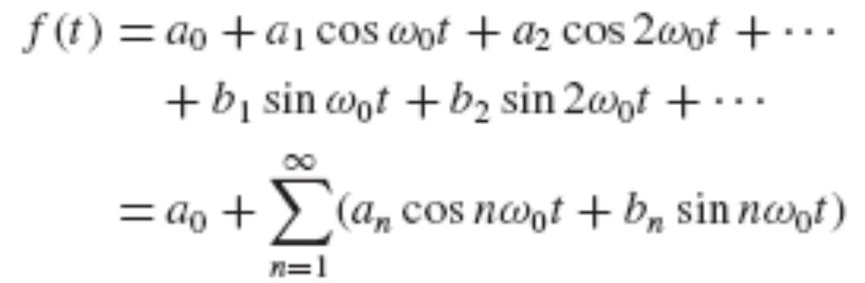
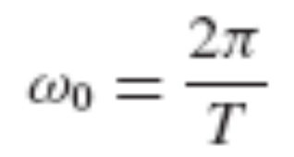
The Fourier theorem states that f(t) may be represented by the infinite series
where the fundamental frequency ω₀ is related to the period T by
where a₀, a_{n}, and b_{n} are constants that depend upon n and f(t). Equation [1] is the trigonometric form of the Fourier series for f(t), and the process of determining the values of the constants a₀, a_{n}, and b_{n} is called Fourier analysis.

Slide 12
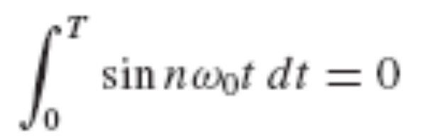

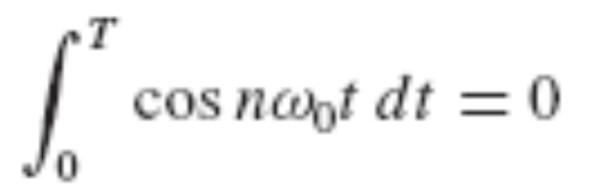

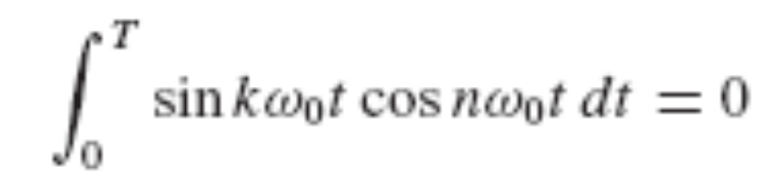


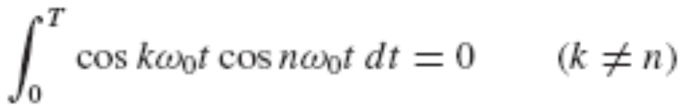

Some Useful Trigonometric Integrals
Let both n and k represent any element of the set of integers 1, 2,3,….
0 and T are used as the integration limits.

Slide 13
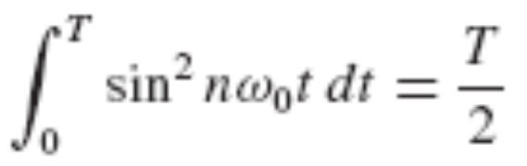
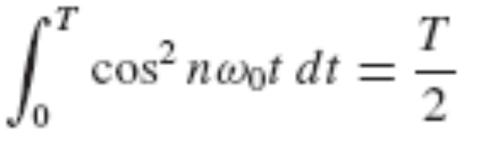


Slide 14
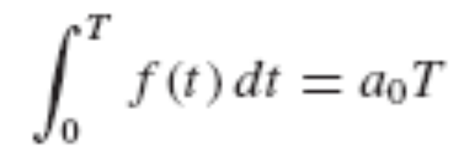
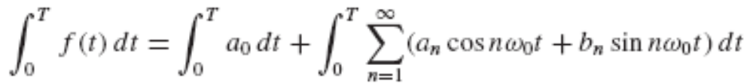
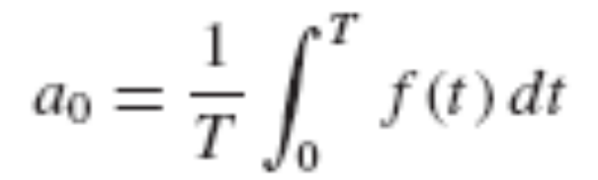
Evaluation of Fourier Coefficients
Take integral on the both sides of the Fourier series.
Every term in the summation is of the form of Eq. [2] or [3], and thus
This constant a₀ is simply the average value of f(t) over a period, and we therefore describe it as the dc component of f(t).

Slide 15
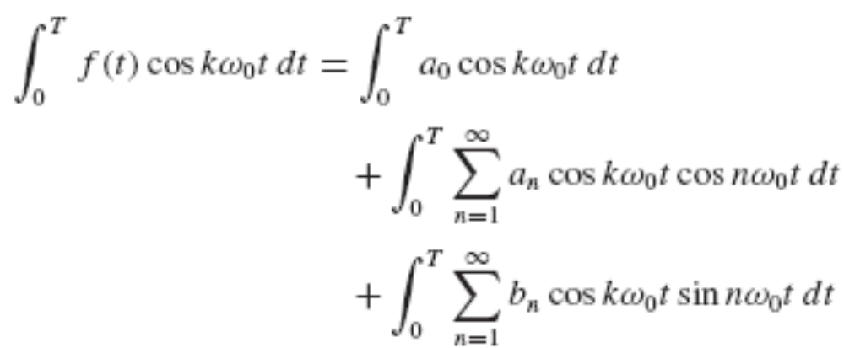
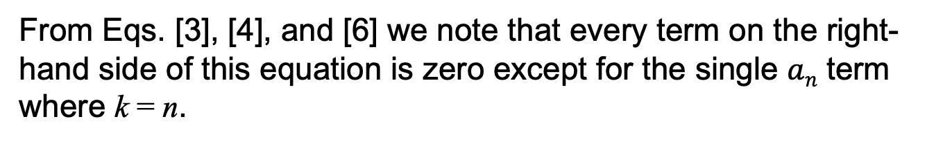
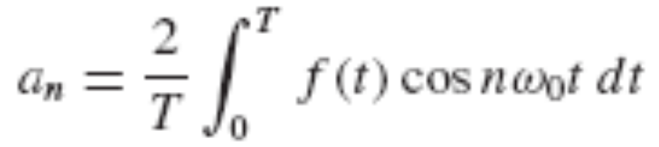


k = n
By using a similar way, we get

Slide 16
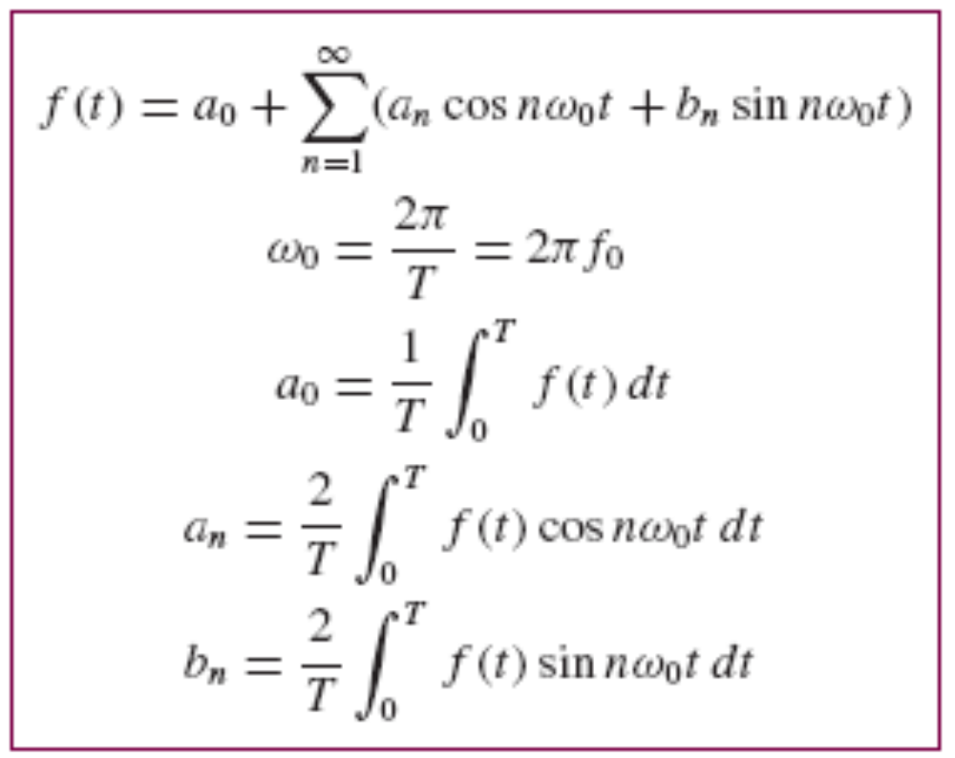
Eqs [9] to [11] now enable us to determine values for a₀ and all the a_{n} and b_{n} in the Fourier series, Eq. [1], as summarized below:

Slide 17
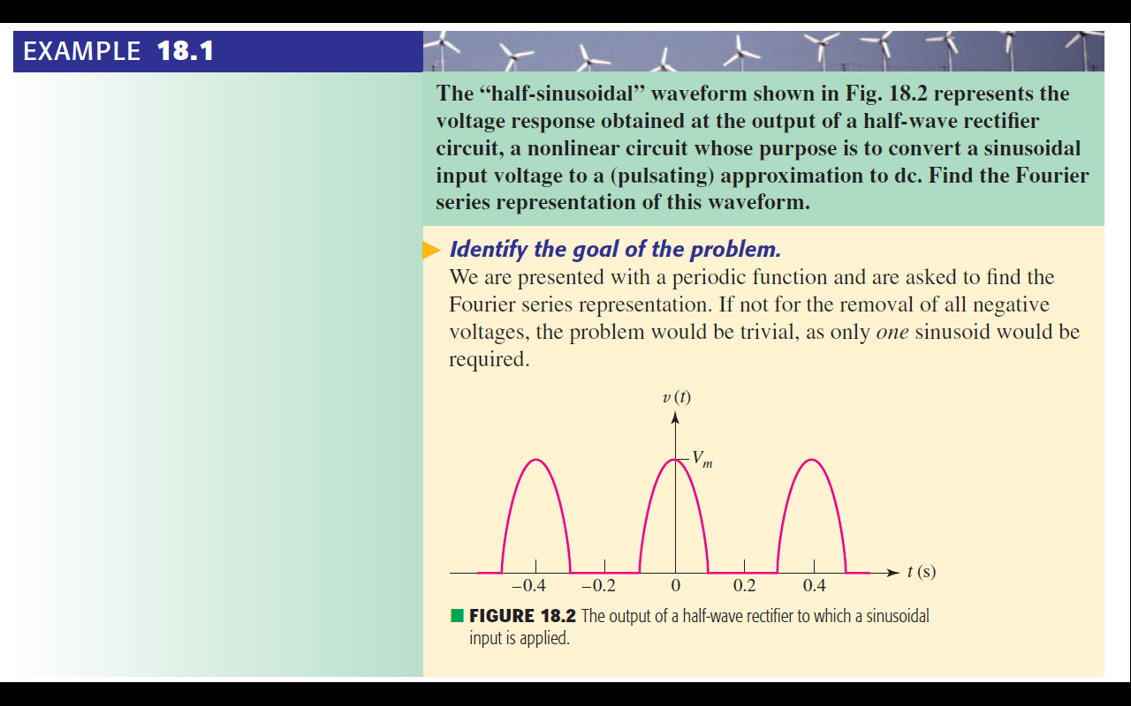
Example 18.1
Th.

Slide 18
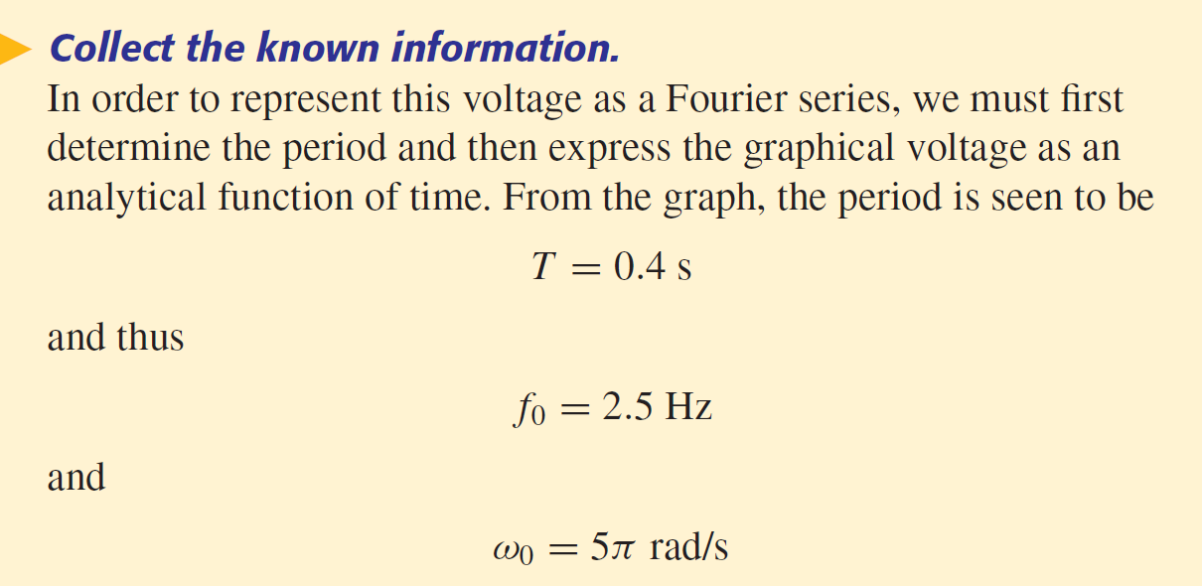
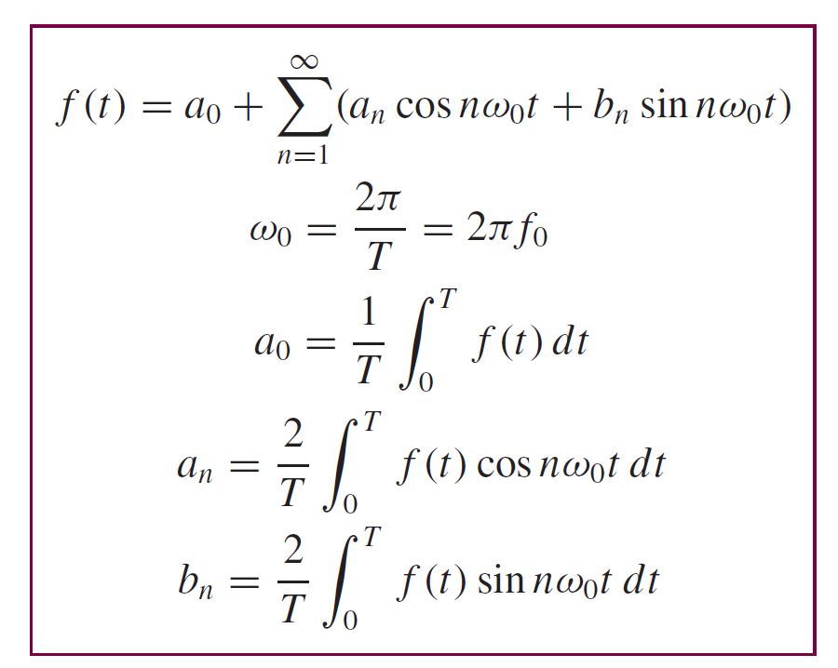
Eqs

Slide 19
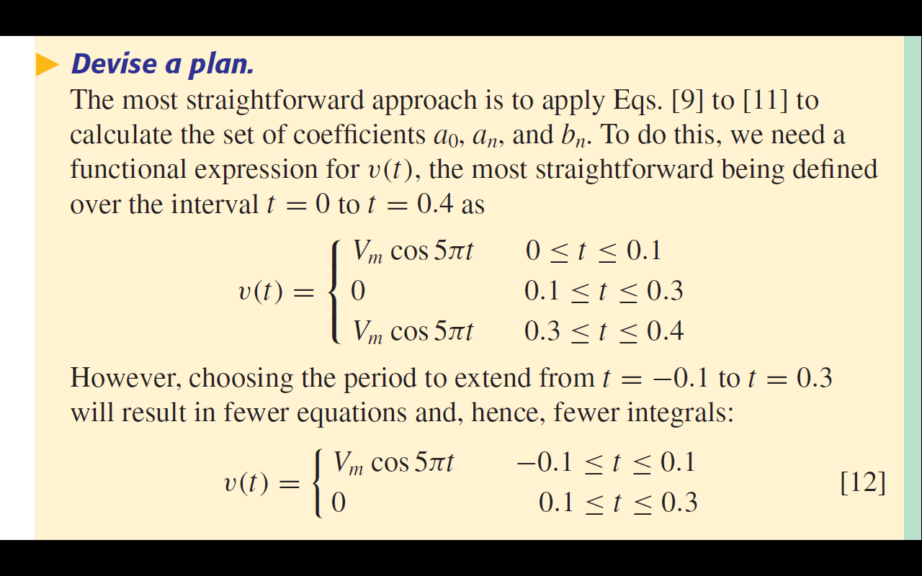
Eqs

Slide 20
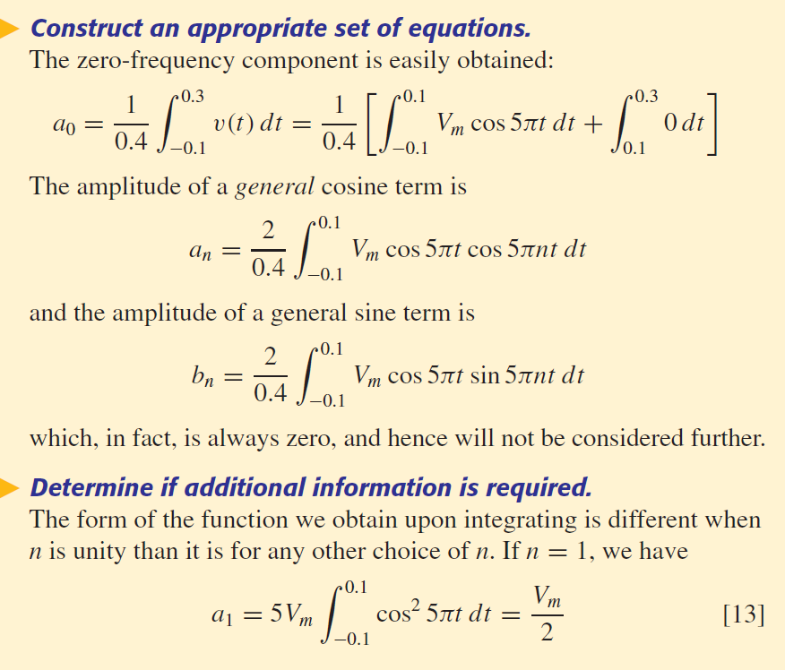


Eqs [9] to [11] now enable

Slide 21
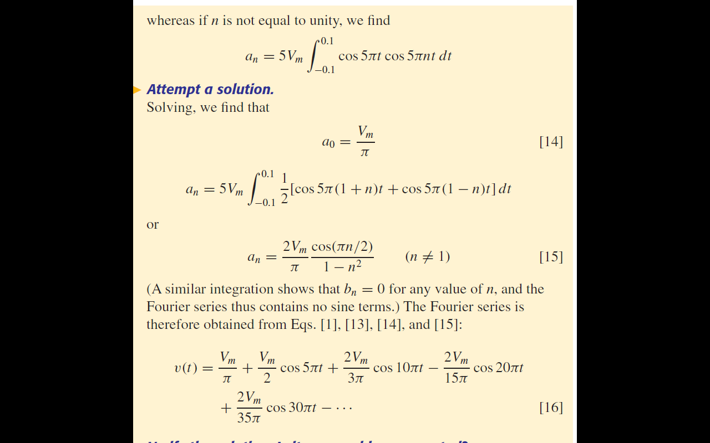
Eqs [9] to [11]

Slide 22
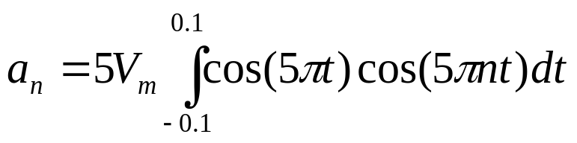
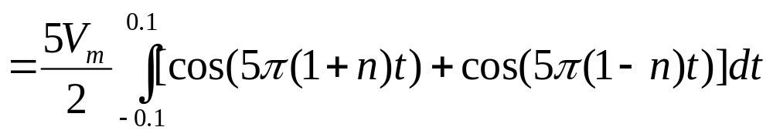
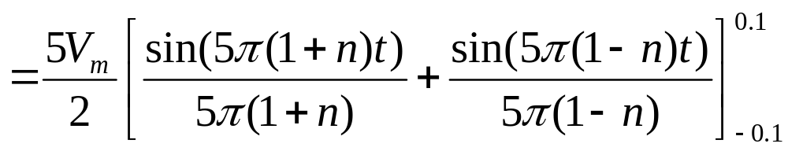
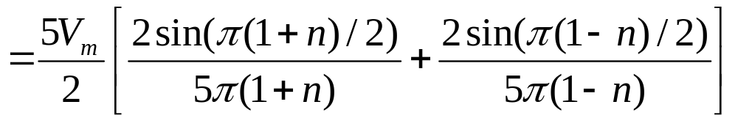
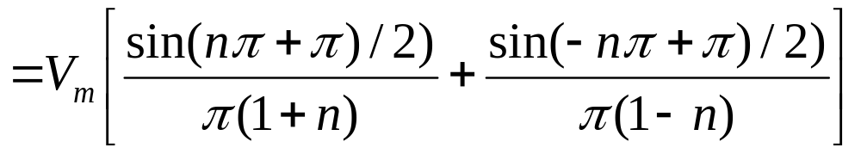
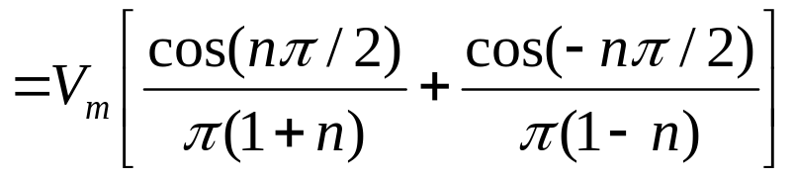
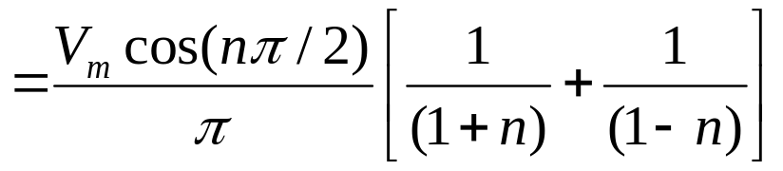
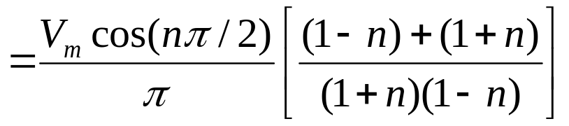
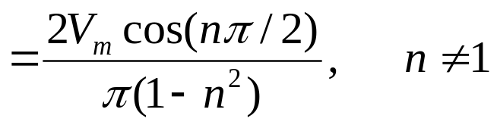

Slide 23
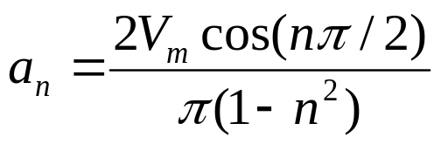
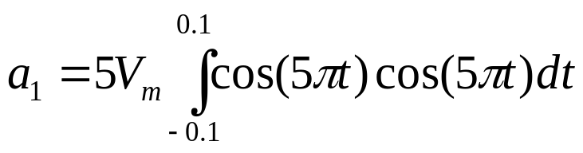
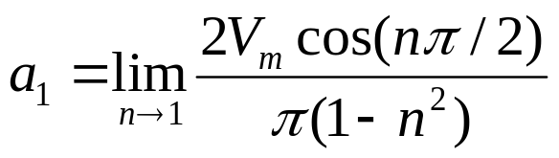
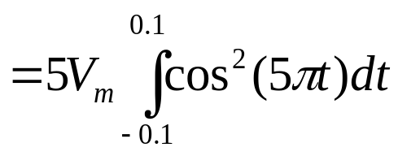
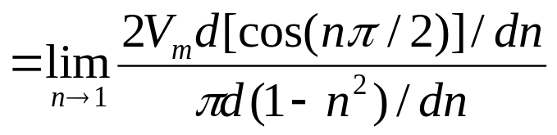
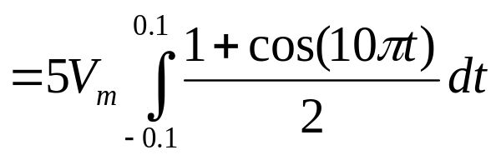
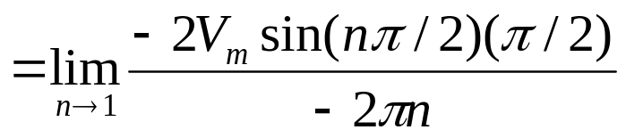
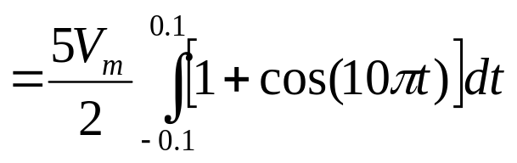
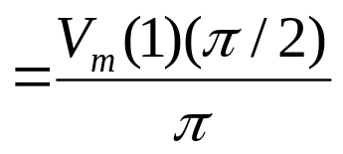
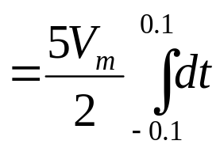
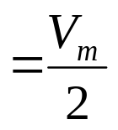

Slide 24
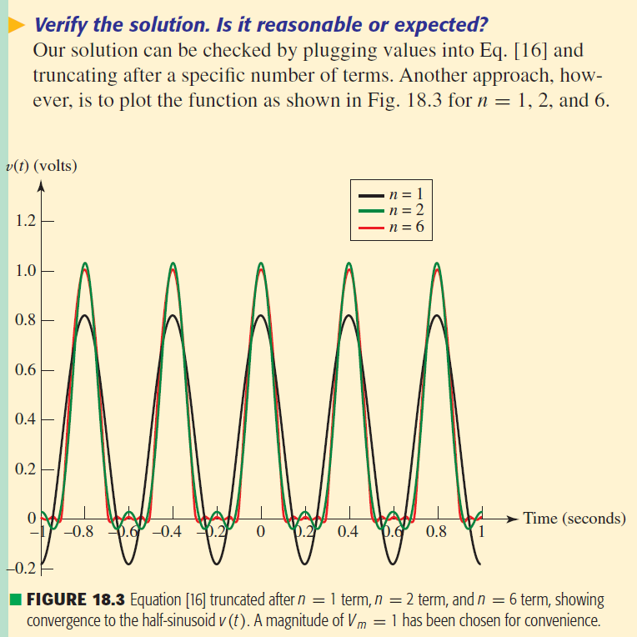
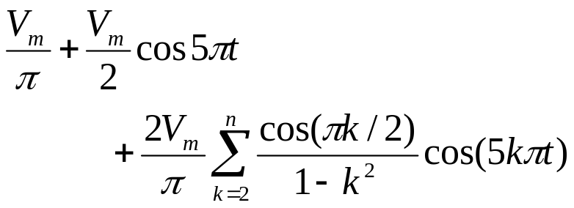
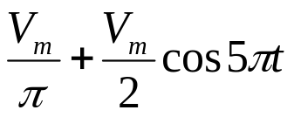
Eqs [9] to [11]

Slide 25
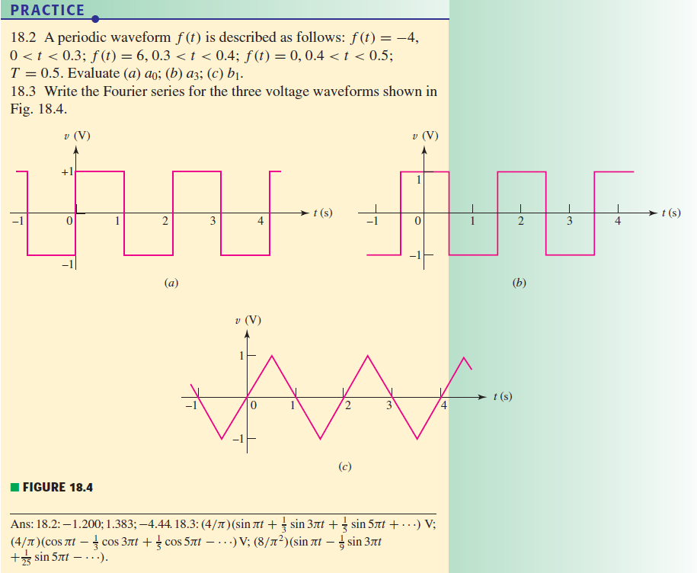
Example 17.1
Calculate shown in Fig 17.3.

Slide 26
Line and Phase Spectra
We depicted the function v(t) of Example 18.1 graphically in Fig. 18.2, and analytically in Eq. [12]—both representations being in the time domain.
The Fourier series representation of v(t) given in Eq. [16]
is also a time-domain expression, but may be transformed into a frequency-domain representation.

Slide 27
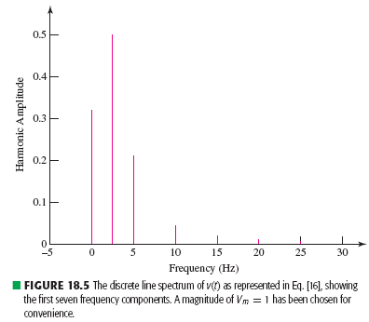






Fig. 18.5 shows the amplitude of each frequency component of v(t), a type of plot known as a line spectrum.
Such a plot, sometimes referred to as a discrete spectrum.

Slide 28






Another trigonometric form of Fourier series
where

Slide 29







Consider
Compare it to
We obtain
and
as well as
and

Slide 30


Consider
In addition to the amplitude spectrum , we also may construct a discrete phase spectrum.
In Eq. [16]:
we get φ_{n} = 0° or 180° for every n.

Slide 31




18.2 The Use of Symmetry
Even and Odd Symmetry
f(t) possesses the property of even symmetry if
The function shown in Fig. 18.6a possesses even symmetry.
If odd symmetry is a property of f(t), then

Slide 32

For example,
t, sin t, t cos (70t), ,
and the function sketched in Fig. 18.6b are all odd functions and possess odd symmetry.

Slide 33
The product of two functions with even symmetry, or of two functions with odd symmetry, yields a function with even symmetry.
even function x even function = even function
odd function x odd function = even function
The product of an even and an odd function gives a function with odd symmetry.
even function x odd function = odd function

Slide 34


If f(t) is an odd symmetric function, then the integration over a symmetric interval about t = 0 is zero.
If f(t) is an even symmetric function, then the integration over a symmetric interval about t = 0 can be expressed as:

Slide 35


Symmetry and Fourier Series Terms
Even Symmetry
The Fourier series of any even function is composed of only a constant and cosine functions.
Let us replace the variable t in the first integral by −τ, or τ = − t, and make use of the fact that f(t) = f(−t) = f(τ):

Slide 36



Thus,
Therefore, if f(t) shows even symmetry, then b_{n} = 0; conversely, if b_{n} = 0, then f(t) must have even symmetry.
A similar examination of the expression for an leads to an integral over the half period extending from t = 0 to t = T/2 :

Slide 37




Odd Symmetry
A function having odd symmetry can contain no constant term or cosine terms in its Fourier expansion.
Let t = −τ in the first integral:
Since f(−τ) = −f (τ), and then

Slide 38

With odd symmetry, therefore,
a_{n} = 0 and a₀ = 0;
conversely,
if a_{n} = 0 and a₀ = 0, odd symmetry is present.
The value of b_{n} may again be obtained by integrating over half the range.

Slide 39




Half-Wave Symmetry
f(t) possesses half-wave symmetry if
or the equivalent expression,
The square wave (Fig. 18.4a or b) shows half-wave symmetry. The two somewhat similar functions plotted in Fig. 18.7 do possess half-wave symmetry.

Slide 40






Consider the coefficients a_{n}
Substitute the new variable τ = t + T/2 → t = τ –T/2 in the integral I₁:
since

Slide 41




After noting the form of I₂,
The factor (1 − cos nπ) indicates that an is zero if n is even.

Slide 42

A similar investigation shows that b_{n} is also zero for all even n,
It should be noted that half-wave symmetry may be present in a waveform which also shows odd symmetry or even symmetry.

Slide 43
When
a waveform possesses half-wave symmetry and either even or odd symmetry,
then
it is possible to reconstruct the waveform if the function is known over any quarter-period interval.

Slide 44



Slide 45


Slide 46

Example 17.1
Calculate shown in Fig 17.3.

Slide 47
18.3 Complete Response to Periodic
Through the use of the Fourier series, we may now express an arbitrary periodic forcing function as the sum of an infinite number of sinusoidal forcing functions.
The forced response to each of these functions may be determined by conventional steady-state analysis.
The complete response is then obtained as the sum of the forced and natural responses.

Slide 48









Slide 49
Example 17.1
Calculate shown in Fig 17.3.

Slide 50



Example 17.1
Calculate shown in Fig 17.3.

Slide 51

Practice 18.6
Use the methods of Chap. 8 to determine the value of the current sketched in Fig. 18.9 at t equal to.
(a) π/2;
(b) π;
(c) 3π/2.
Ans: 2.392 A; 0.1034 A; 2.396 A.

